Slide 1


3 December, 2022
Sponsored and Supported by:

Slide 2

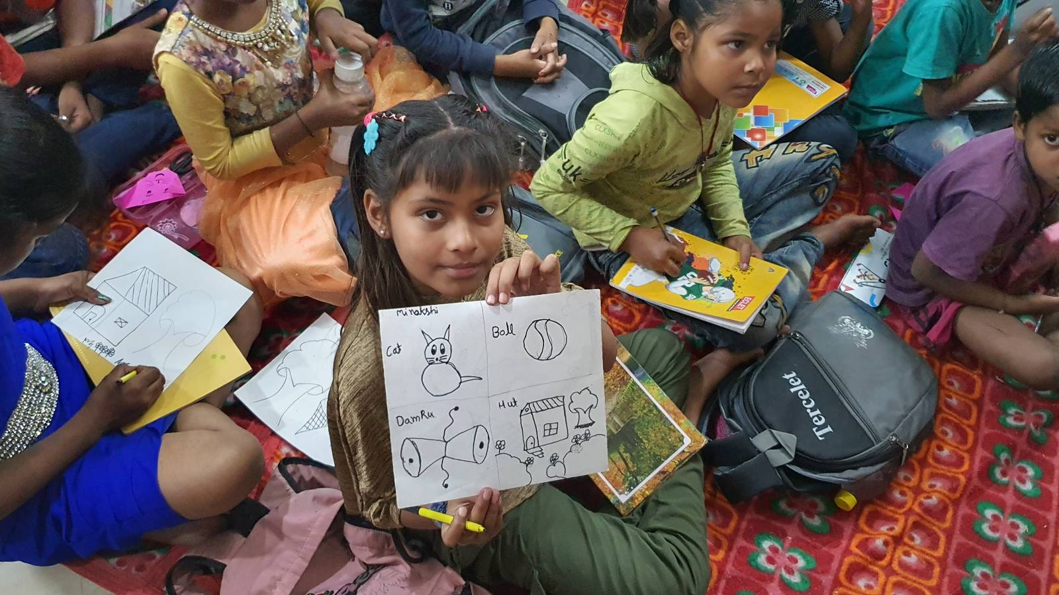
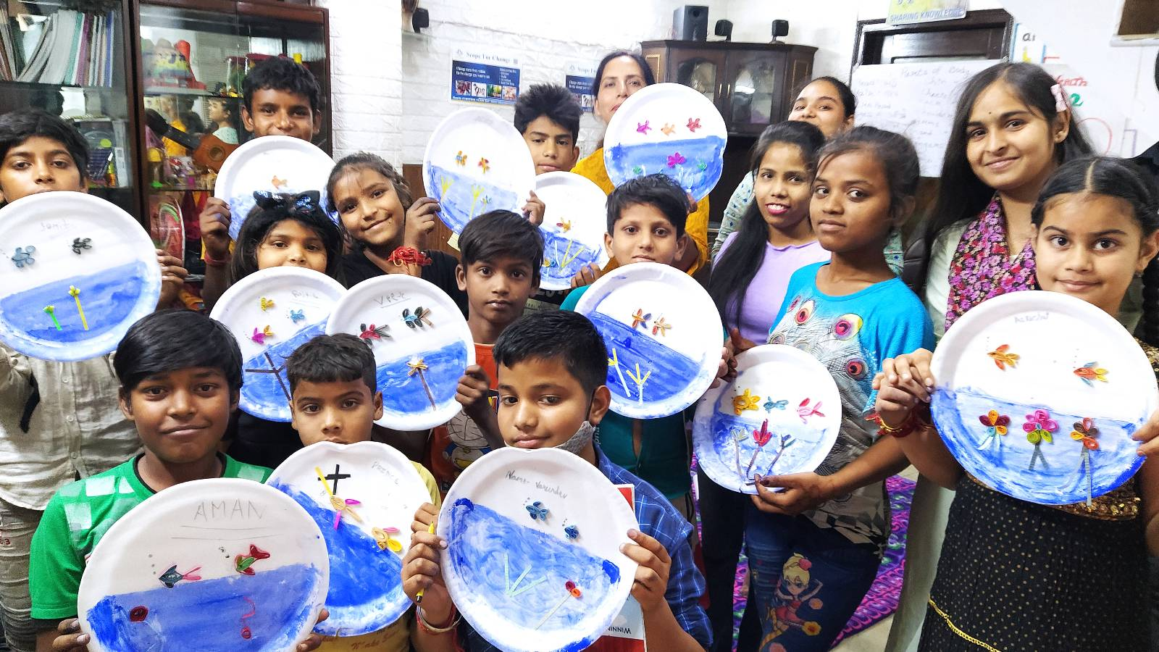

SUPPORT A CAUSE
“Giving is Receiving”
Support ‘Scope for Change’ to create more impact and touch the lives of more underprivileged students.

Slide 3
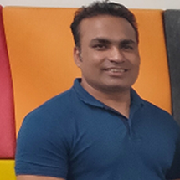





Kirti Prajapati
Extend Microsoft Viva Connections with SPFx
kirti.Prajapati@gmail.com
linkedin.com/in/kirtiprajapati
Modern Workplace Consultant
MVP | MCT
@kirtipprajapati
https://kirtiprajapati.com

Slide 4
Agenda
Microsoft Viva Overview
Microsoft Viva Connections
Set up Microsoft Viva Connections
Extend Microsoft Viva Connections with SPFx

Slide 5
Microsoft Viva
an employee experience platform
spans four categories:
Connections
Learning
Insights
Topics

Slide 6
Microsoft Viva Connections
Improve Employee Experience
Drive Business Decisions
Enhance Employee Engagement

Slide 7
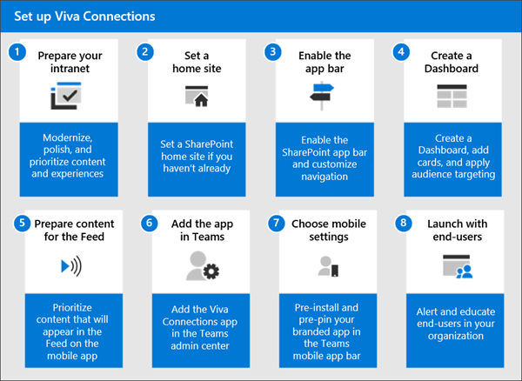
Set up Microsoft Viva Connections

Slide 8
Demo

Slide 9

M365 Saturday Ahmedabad 2023
CFS Close Date: 15 December 2022
CFS Link: https://lnkd.in/d-H5KTFM
Event Type: In-Person event
Event Location: Ahmedabad (Gujarat)
Event Date: 07 January 2023
9:30 AM to 5:30 PM IST
For more details: https://lnkd.in/d5MxSGGV

Slide 10








A Big Thank You to all the Sponsors!
Diamond:
Learning Partner:
Platinum:
Gold:

Slide 11
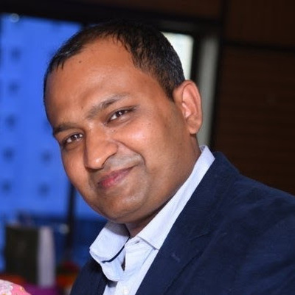
Manoj Mittal
Next Session
SharePoint Syntex | automated SharePoint content classification and data extraction
Sr. Consultant | Modern Work | Microsoft

